Slide 1
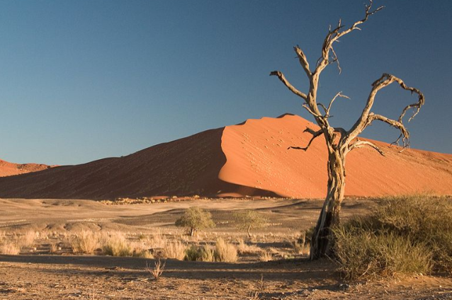
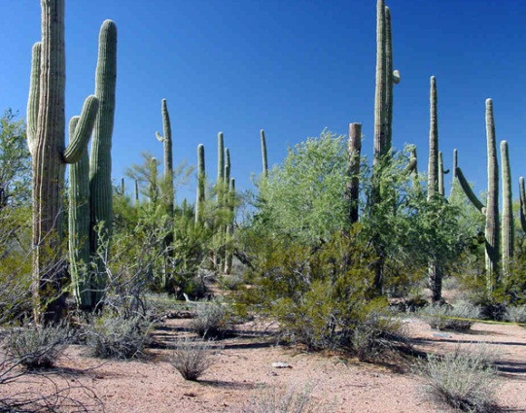
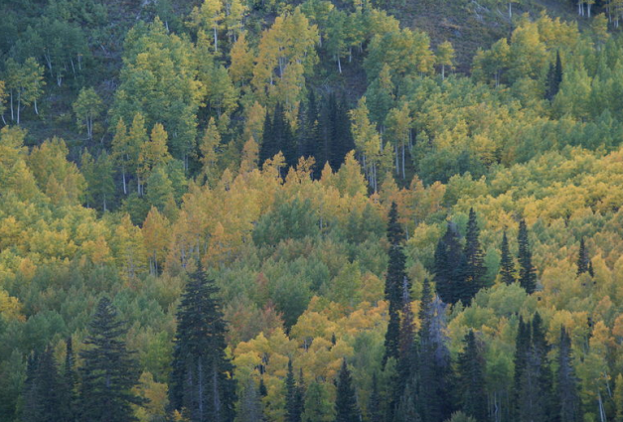
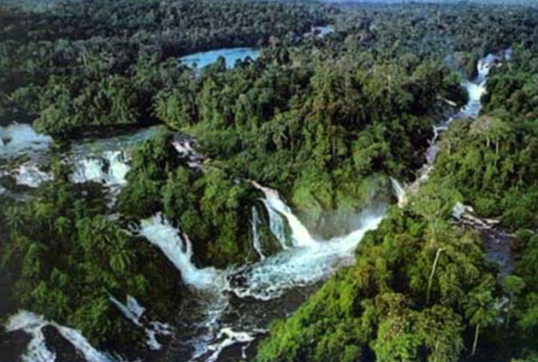
Biogeographic regions
Similarity

Slide 2
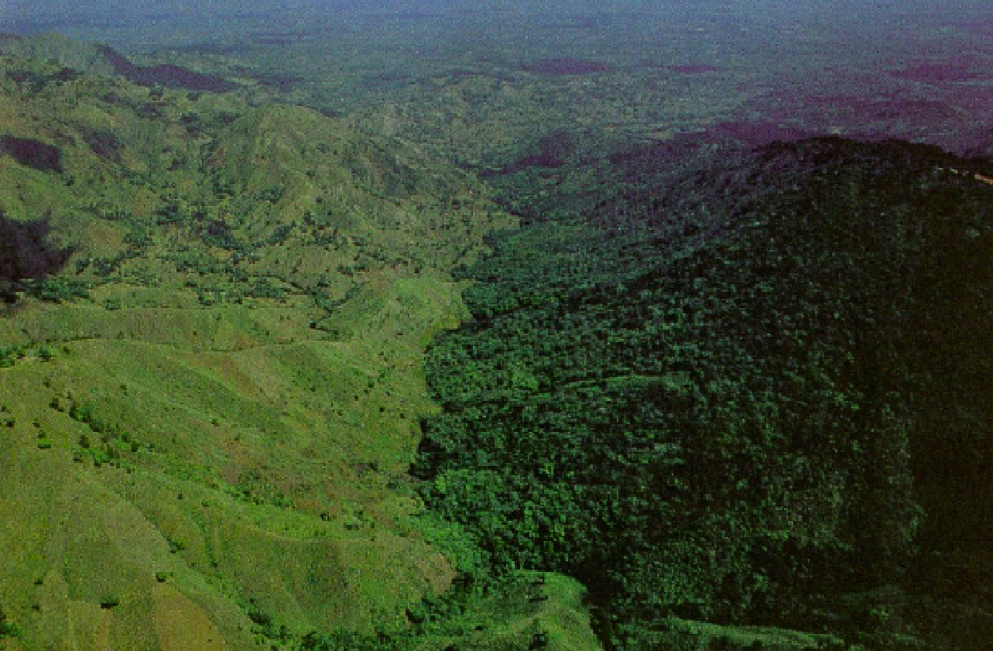
Biogeographic regions
The pattern:
different parts of the world have similar types of species
The challenge:
How do we set the boundaries of those places?

Slide 3
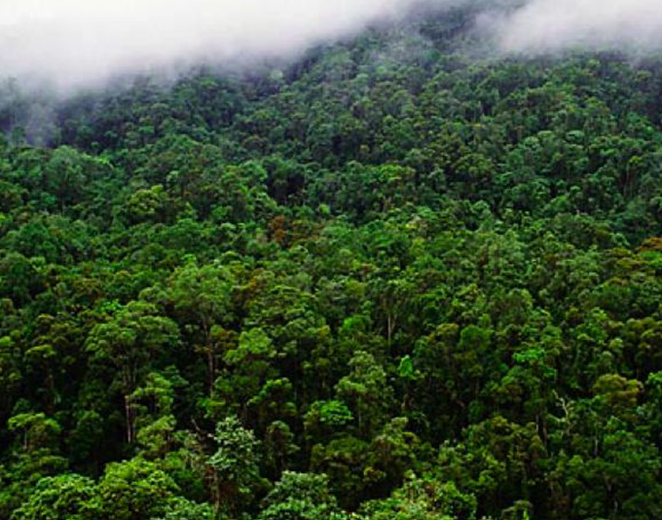
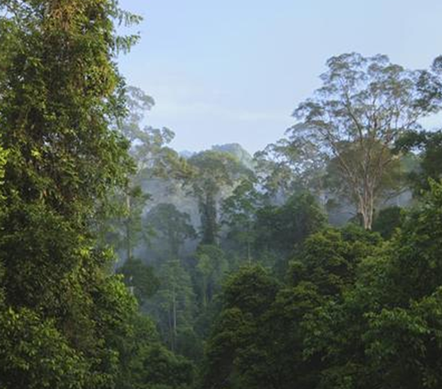
First: differentiate climate and evolution
Costa Rica
New Guinea
SIMILAR in their vegetation type and structure, climate, soils, etc
BIOMES
DIFFERENTIATED by plants and animals with very different evolutionary histories
BIOGEOGRAPHIC REGIONS

Slide 4
The raw data
Species is:
Presence
Absence
The process →
Speciation
Dispersal
Extinction

Slide 5
Raw data and patterns
Species richness
Species similarities
Count
Similarity
Endemic
Species distributions
Cosmopolitan
Temperate Tropics Temperate
Latitude

Slide 6
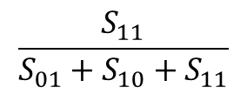
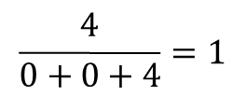
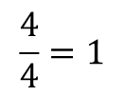
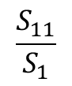
Building the pattern
$$\frac{S_{11}}{S_{01}+S_{10}+S_{11}}$$
$$\frac{4}{0+0+4}=1$$
Jaccard:
Temperate Tropics Temperate
Latitude
Simpson:
$$\frac{S_{11}}{S_{1}}$$
$$\frac{4}{4}=1$$

Slide 7
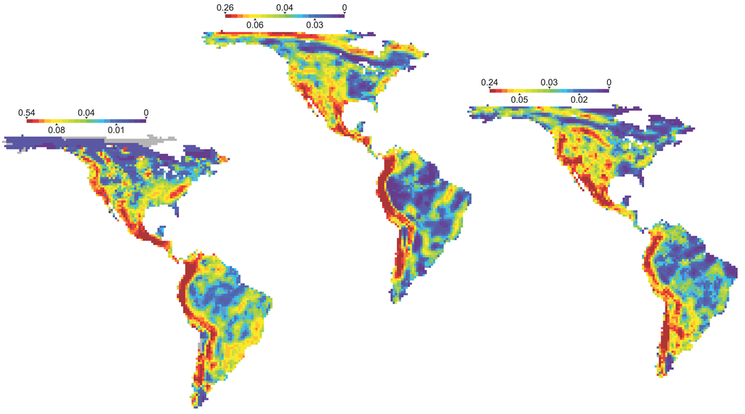
GLOBAL PATTERN OF BETTA DIVERSITY
Birds
Very dissimilar
Very similar
Mammals
Amphibians
McKnight et al, PlosBiology 2007

Slide 8
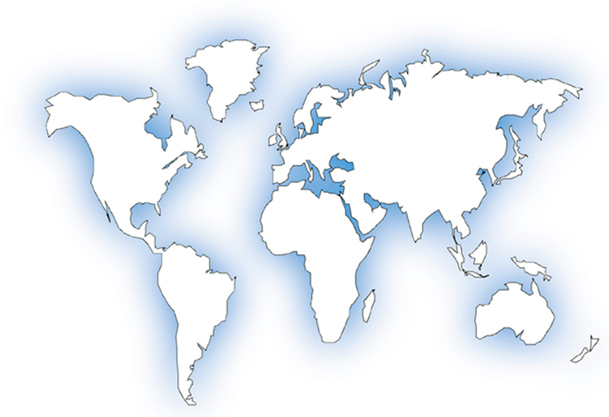
Problems: choice of scale and need for a hierarchy
How did you get to be here?
The problem of scale:
here → my desk
here → Honolulu
here → Hawaii
here → USA
here → Earth
Sub-divisions
Provinces
Regions
Realms

Slide 9
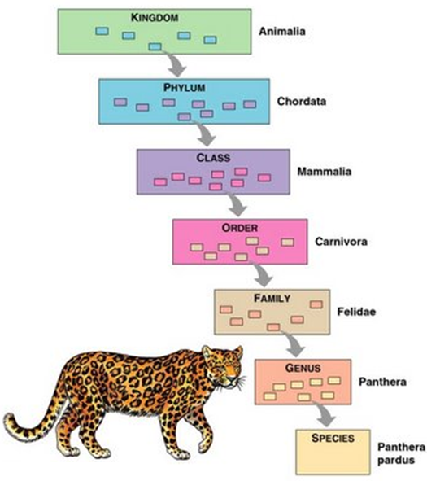
Problems: choice of taxonomic level
Country | Genus | Species
Canada | Larix | laricina
 | Picea | glauca
 | Picea | mariana
 | Pinus | banksiana
Russia | Larix | sibirica
 | Picea | obovata
 | Pinus | sylvestris
Simpson coefficient | 1.0 | 0.0

Slide 10

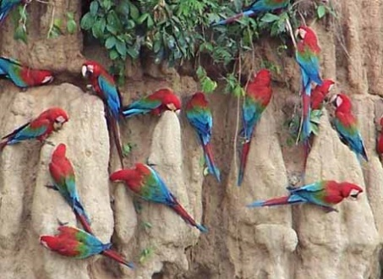
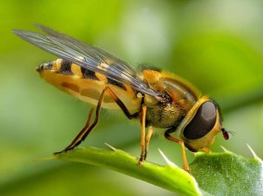
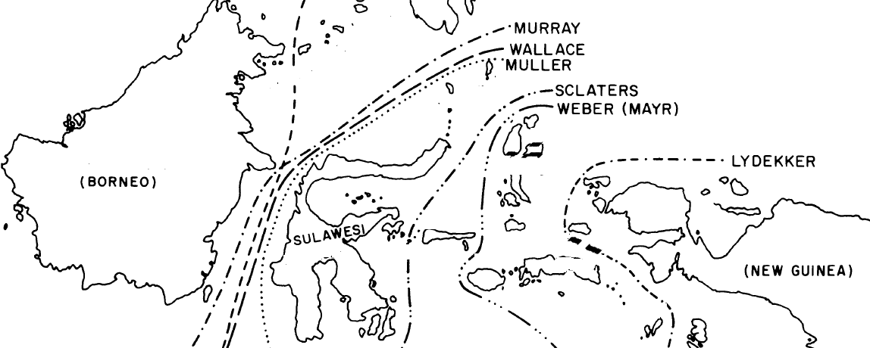
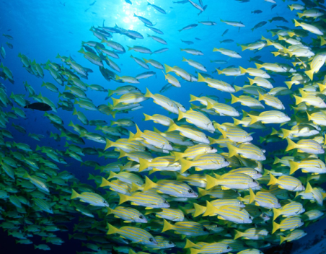
Problems: choice of taxa
Speciation
Dispersal
Extinction
Wallace’s Line
Simpson, Proceedings of the American Philosophical Society 1977

Slide 11

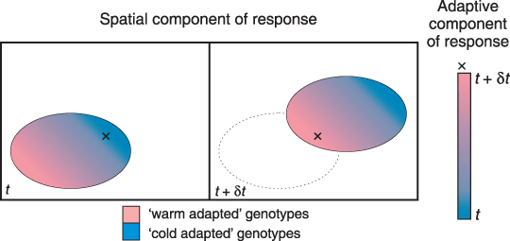
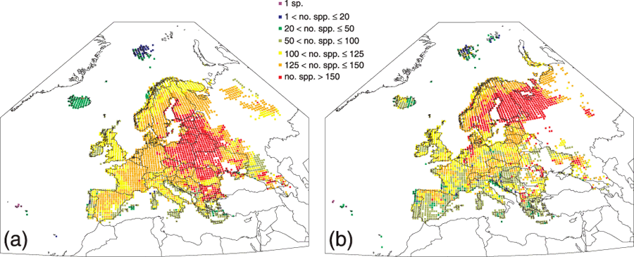
Potential impacts of climatic change upon geographical distributions of birds
Problems: temporal changes (Climate change)
NOW
2070
HUNTLEY et al. IBIS 2006
Notes:
Simulated present and potential future diversity of European breeding birds. The left‐hand map (a) shows the number of species simulated breeding in each grid square for the present climate, whilst the right‐hand map (b) shows the number of species simulated as potentially breeding in each grid square for a potential future climate scenario for 2070–99 derived from the HadCM3 simulation for the SRES B2 emissions scenario.
© This slide is made available for non-commercial use only. Please note that permission may be required for re-use of images in which the copyright is owned by a third party.

Slide 12
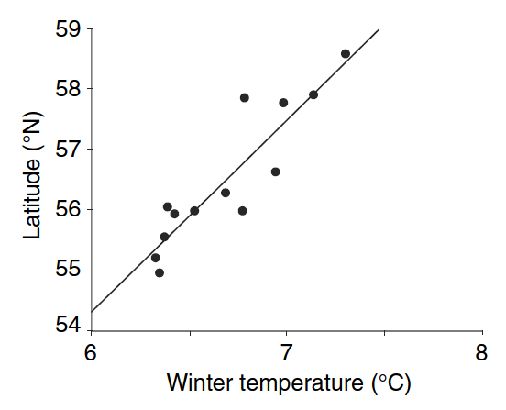
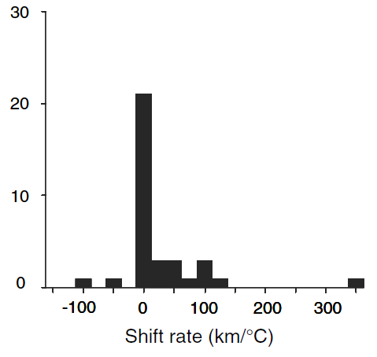
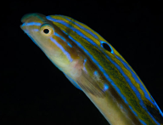
Problems: temporal changes (Climate change)
North Sea fishes are shifting north with climatic warming
snake blenny
Average north shifting: 172 km between 1977 and 2001
Number of species
Perry et al, Science 2009

Slide 13
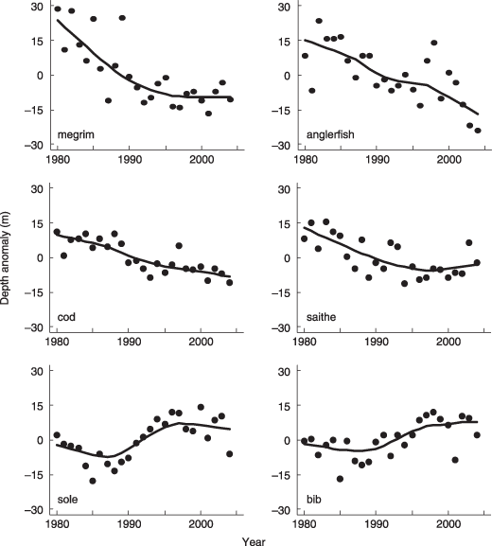
Problems: temporal changes (Climate change)
Climate change and deepening of the North Sea fish assemblage: a biotic indicator of warming seas
Fishes are not going extinct now but are moving deeper
Dulvy et al, journal of Applied Ecology 2008

Slide 14
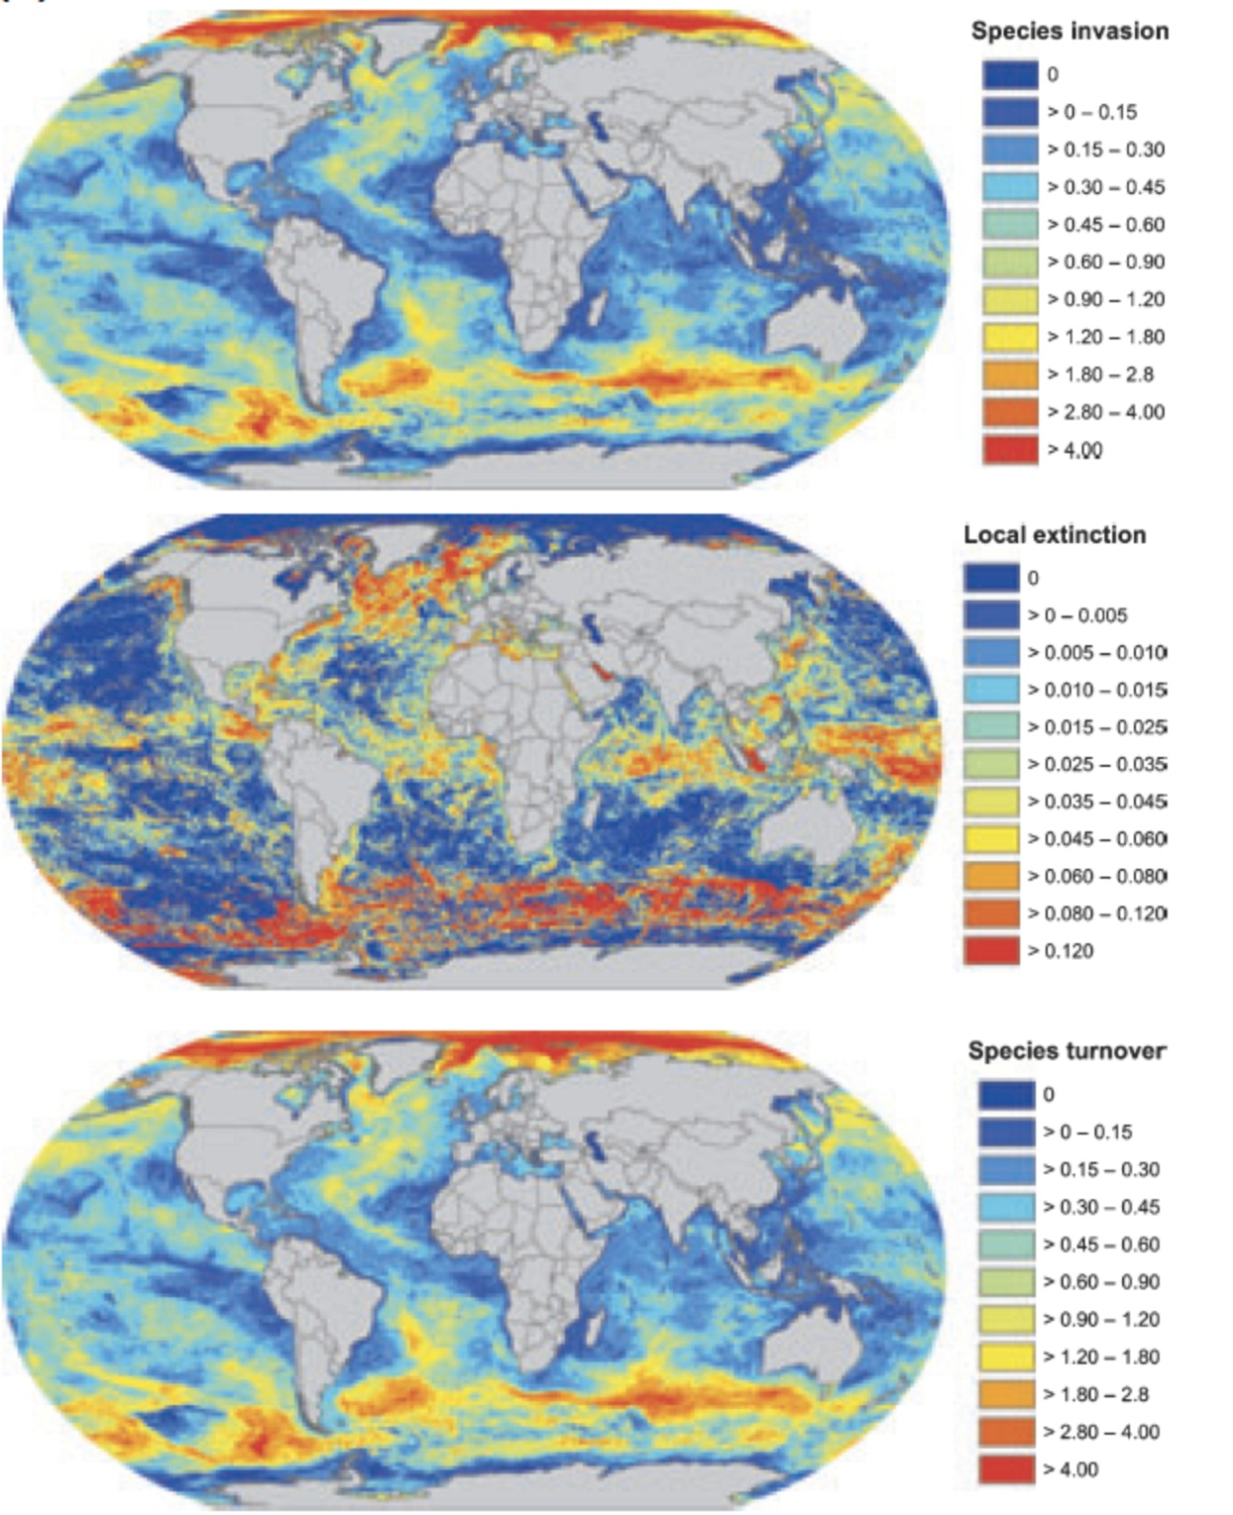
Problems: temporal changes (Climate Change)
Invasion and local extinctions can change the structure of local assemblages by up to 60% by 2050
Cheung et al. Fish and Fisheries 2009

Slide 15
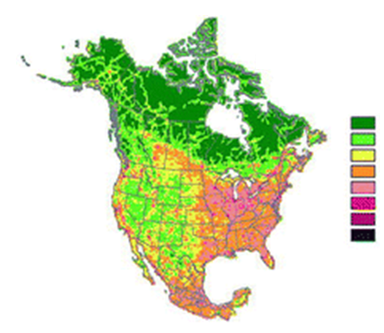
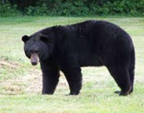
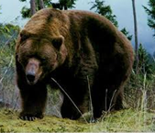
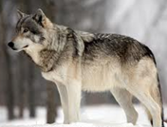
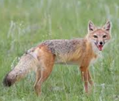

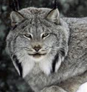
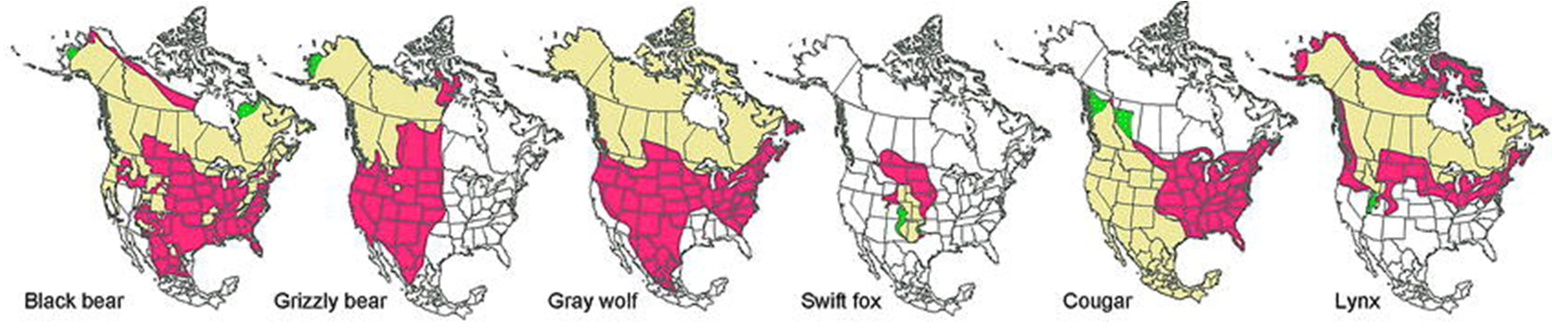
Problems: temporal changes (Anthropogenic)
Low
Human Influence index
High
LALIBERTE & RIPPLE, Bioscience 2004

Slide 16
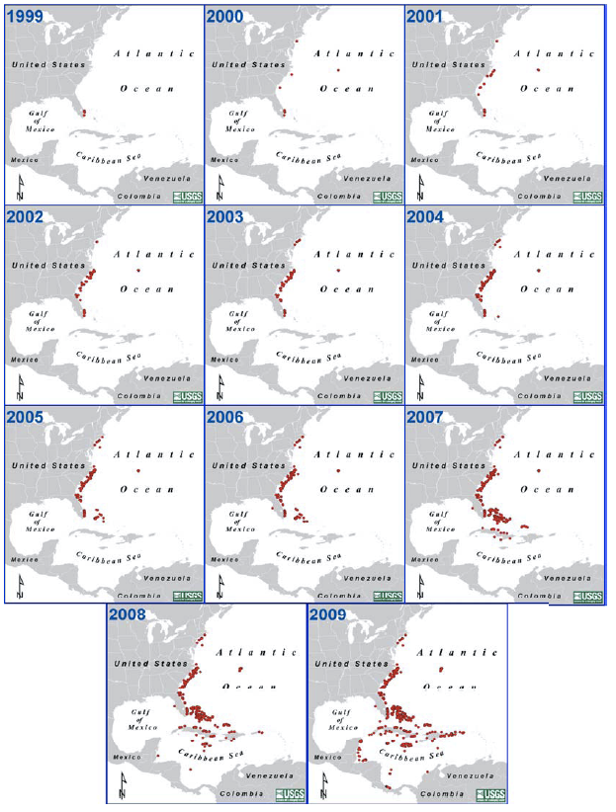
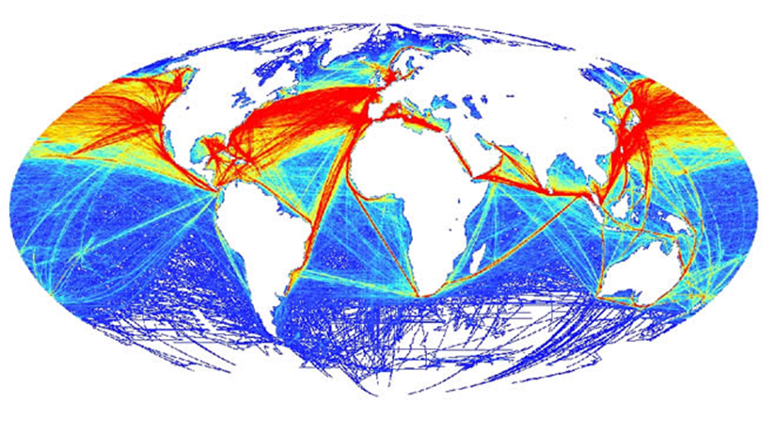
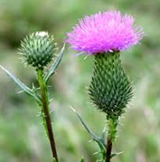
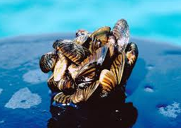

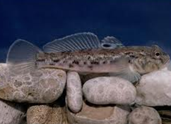
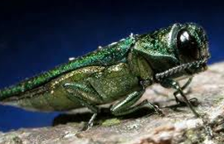
Problems: range shifts (Invasive species)
SPECIES ARE MOVING AROUND
GLOBAL SHIPPING LINES
Schofield, Aquatic Invasions 2009

Slide 17
There is no clear cut way to define biogeographical regions

Slide 18
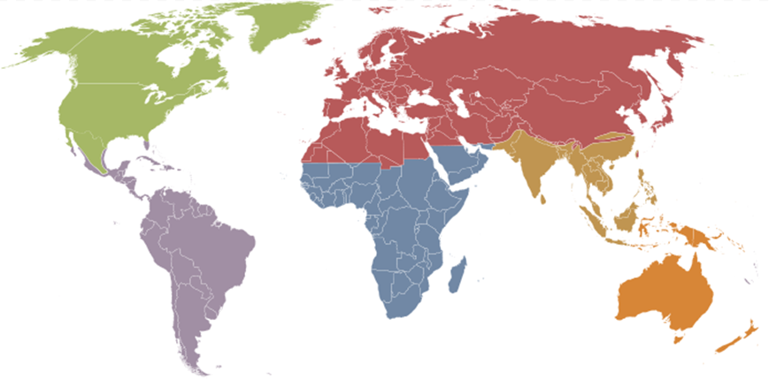
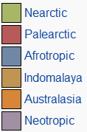
Biogeographical regions of the world: Udvardy's system
Udvardy, IUCN 1975

Slide 19
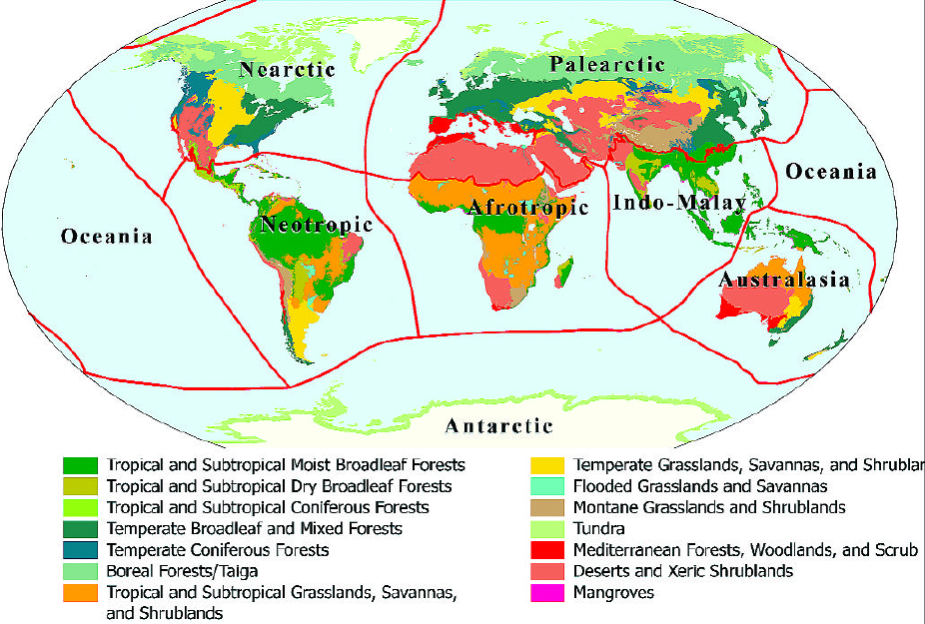
Biogeographical regions of the world: WWF
Olson et al, Bioscience 2001

Slide 20
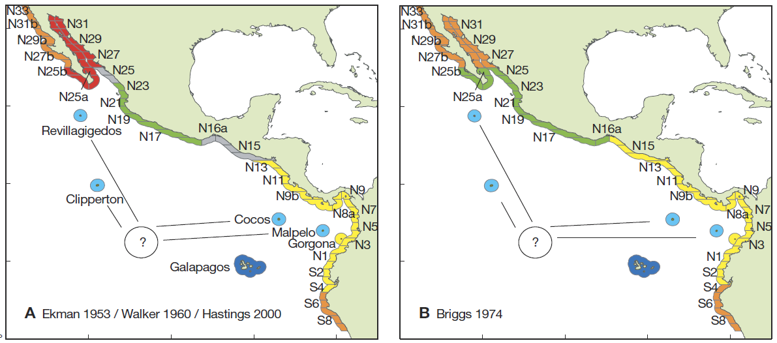
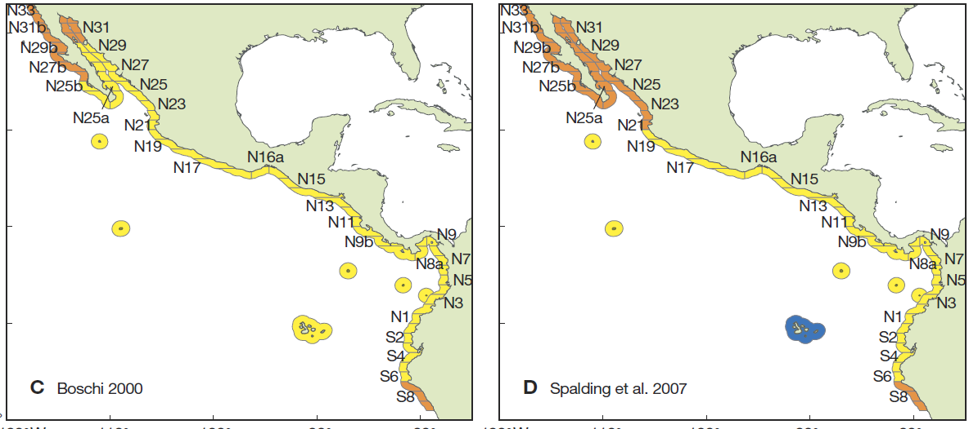

Biogeographical regions of the world: problems at small scales
Robertson and Cramer, MEPS 2009

Slide 21
Biogeographical regions
Summary
Scale
Taxonomic rank
Difficult to define
Taxonomic group
Change over time
Climate
Human exploitation
Very variable
Invasions

